Slide 1
WORKING WITH LAYERS

Slide 2
Introduction to Layers
In Photoshop, layers are used to work on individual parts of an image while not affecting other parts.
You might say that layers are like transparency papers stacked on top of one another which can be repositioned and separately drawn on without disturbing each other.

Slide 3

Consider the following Graphic created in Adobe Photoshop:
To the viewer, this is simply one flat graphic. However, in Photoshop, it is actually 4 separate layers (graphics if you will) stacked on top of one another. There is a Blue Background layer, two separate layers with a T9 Cloud, and a top layer with the “Tutorial9″ text.

Slide 4
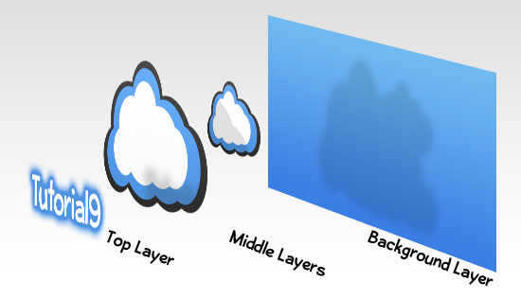

Slide 5
Background Layer
When you create a new image with a white background or colored background, the bottom most image in the Layers is Background.
An Image can have only one background.

Slide 6
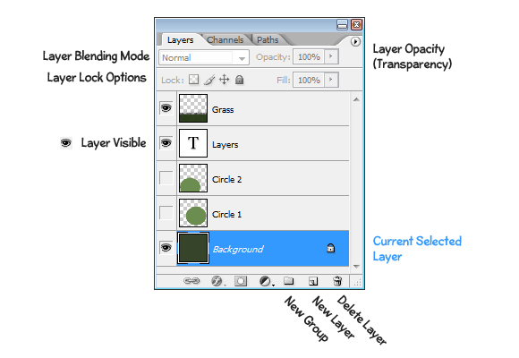
Layer Palette
Layers: The layer palette contains all the layers in the image.
Eye: The eye icon present on the left most column of the layers palette indicate the visibility of the layer.we can show/hide layers using this icon.
Blending mode: It tells how the pixels blend with the pixels of the image. We can have no of effects using this blending modes.
Menu Option – Window – Layers

Slide 7
Operation on Layers
Adding Layers
Viewing/Hiding Layers
Removing Layers
Reordering Layers
Renaming Layers
Setting Opacity Value

Slide 8
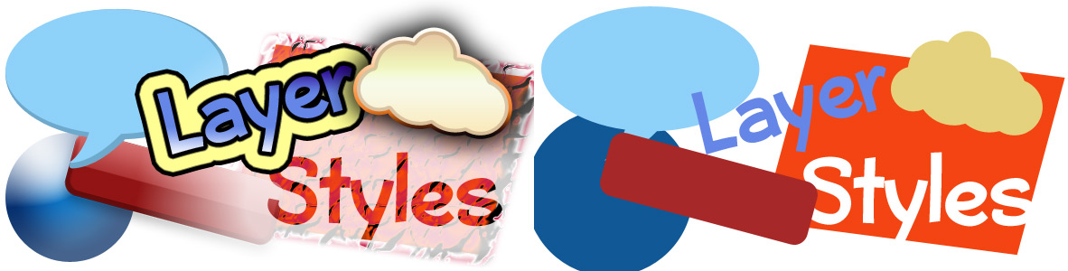
Layer Effects
Effects can be added to individual layers in Photoshop that automatically change as a layer is modified.
The combination of effects on any given layer is called its Layer Style.

Slide 9
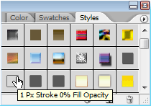
Using Layer Presets
Photoshop comes up
with a good number of
Layer Style Presets,
all which are accessible
through the Styles Palette (Window > Styles).
To apply a Layer Style, select the Layer you’d like to work with in your document from the Layers Palette, and then select the Layer Style which you would like to apply.

Slide 10
Layer Style Options
To add your own layer effects, and create your own styles, go to Layer > Layer Style > Blending Options, or Right Click your Layer, and select Blending Options. This will bring up the Layer Style Options.

Slide 11
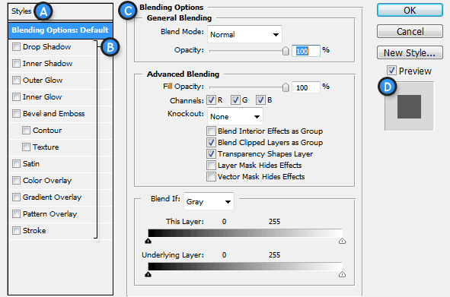

Slide 12
Explained …
A. Style Presets – List of the Style Presets.
B. Effects – The various effects that can be used in a layer style. It’s important to note that by clicking on the name of any of the effects will enable that effect, and display the options for the individual effect.
C. Options / Settings – When the name for an effect is checked, it’s options will be shown here. When Blending Options is selected, settings such as Opacity, Fill, and other advanced options will be displayed.
D. Layer Style Preview – A preview of the Layer Style.

Slide 13
Various Effects ..
Layer Effects – Styles can be built with the following effects:
Drop Shadow – Creates a shadow behind the layers contents.
Inner Shadow – Creates a shadow on top of the layers contents.
Outer Glow - Creates a glow behind the layers contents.
Inner Glow – Creates a glow on top of the layers contents.
Bevel and Emboss - Used to create unique highlight and shadow effects on a layers contents.
Satin - Gives the layer contents a satin-like, glossy appearance.
Color Overlay - Fills the layer contents with a solid color.
Gradient Overlay - Fills the layer contents with a gradient.
Pattern Overlay - Fills the layer contents with a pattern.
Stroke - Creates an outline on layer contents using a solid color, gradient, or pattern.

Slide 14
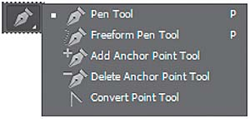
More Tools …
Pen Tool –
The Pen Tool is all
about drawing "paths".
The Two Pen Tool Modes –
  Fill pixels icon, is grayed out and not available when working with the Pen Tool.
  The icon on the left is the Shape layers icon, If we were to work by drawing shapes, just as if we were using any of the various Shape Tools, except that instead of drawing a predefined shape like a rectangle or an ellipse, we could draw any shape we wanted.
  We want the icon beside it, the Paths icon, so go ahead and click on it to select it:

Slide 15
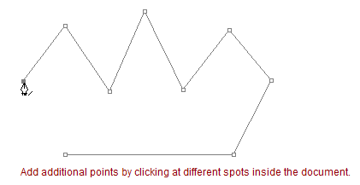
Working with Pen Tool
This first point we've just added is the starting point of our path.
The "point" is technically called an anchor or anchor point

Slide 16
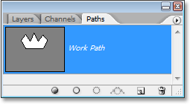
More …
Closing A Path :- To close a path, all we need to do is click once again on our initial starting point. When you hover your mouse cursor over the starting point, you'll see a small circle appear in the bottom right corner of the pen icon
Turning A Path Into A Selection :- (By Using Path Palette)
  Make Selection
  Fill Path
  Stroke Path

Slide 17
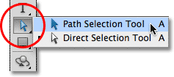
Another Selection Tool
You can select an entire
path using the
Path Selection Tool
(also known as the "black arrow" tool), or you can select individual points or path segments using the Direct Selection Tool (the "white arrow" tool).

Slide 18
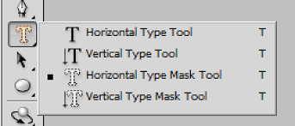
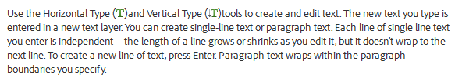
Type Tool

Slide 19
Options Provided by Type Tool
In the options bar, set the following Type tool options:
Font Family
  Applies a font family to new or existing text.
Font Style
  Applies font styles, such as bold, to new or existing text.
Font Size
  Applies a font size to new or existing text.
Color menu
  Applies a color to new text or selected text.
Align Text
  Specifies text alignment. If text orientation is horizontal, lets you align text: left, center, or right. For vertical orientation text: top, center, or bottom.
Warp text
  Warps text on the selected layer.

Slide 20
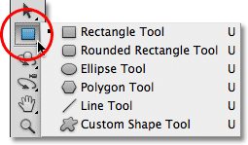
Working with Shape Tools(U)
Rectangle Tool
Rounded Rectangle Tool
Ellipse Tool
Polygon Tool
Line Tool
Custom Shape Tool

Slide 21

Common Options
Vector Shapes are resolution-independent and fully scalable, which means we can make them as big as we like and resize them as often as we like without any loss of image quality.
To draw vector shapes, select the Shape Layers option in the Options Bar.
Paths mode available from this menu which can be used to create a pen path based on the shape tool settings.
Pixels mode which can be used to simply draw a shape and fill with the current foreground color.

Slide 22
Another Properties
Rounded Rectangle Tool – Radius
Polygon Tool – Sides
Line Tool – Width
Custom Shape Tool - Shape

